Slide 1
Templates
Generic functions and classes
Programming – Introduction to C++
Last modified 4/11/15 by Jeff Cotter

Slide 2
Contents
Normal Functions
Template Functions
Template Classes
Template Dangers

Slide 3
Normal Functions
A normal function is:
A list of inputs/outputs
A set of instructions for manipulating data
int Add(int a, int b)
{
return a + b;
}

Slide 4
Normal Functions
If we want a function that does the same thing with a different data-type, we have to make an overload that accepts the new data-type
int Add(int a, int b)
{
return a + b;
}
float Add(float a, float a)
{
return a + b;
}

Slide 5
Template Functions
Template functions solve this problem
Template functions are not functions
Template functions are blueprints for normal functions
Template functions use generic/place-holder data-types
When a previously unused data-type is given to a template function, the compiler generates a new ‘normal’ function that handles it

Slide 6
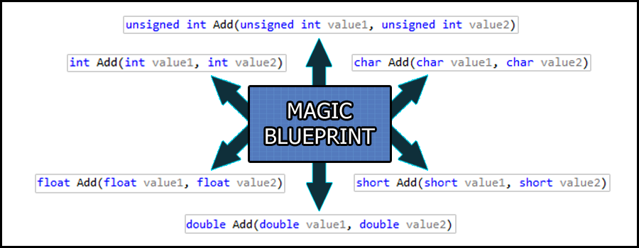
Template Functions

Slide 7
Template Functions
To make a template function we first flag the function with the template keyword
int Add(int a, int b)
{
return a + b;
}
template
int Add(int a, int b)
{
return a + b;
}

Slide 8
Template Functions
We then create a generic data-type with the typename keyword (i.e. template parameters)
template
int Add(int a, int b)
{
return a + b;
}
template<typename T>
int Add(int a, int b)
{
return a + b;
}

Slide 9
Template Functions
Finally we use the generic data-type in place of our otherwise static data-types (where appropriate)
template<typename T>
int Add(int a, int b)
{
return a + b;
}
template<typename T>
T Add(T a, T b)
{
return a + b;
}

Slide 10
Template Functions
We can then invoke the method like normal
The compiler will look at the argument types and generate a copy of the template function, replacing any T’s it finds with the correct data-type (e.g. int)
void main()
{
int i = Add(5, 7); //works!
float f = Add(5.0f, 7.0f); //works!
}

Slide 11
Template Functions
We can also explicitly tell the compiler which data-type to replace T with when it generates the new function at compile-time
We do so by specifying the template type arguments with <typename>
void main()
{
int i = Add<int>(5, 7); //works!
float f = Add<float>(5.0f, 7.0f); //works!
}

Slide 12
Template Functions
If you feed multiple data-types into a template parameter, you must explicitly declare which data-type the compiler should use
template<typename T>
T Add(T a, T b)
{
return a + b;
}
void main(){
int r1 = Add(5, 7.0f); //error!
int r2 = Add<int>(5, 7.0f); //works!
float r3 = Add<float>(5, 7.0f); //works!
}

Slide 13
Template Functions
The rules for data-type conversion still apply when passing values to generic data-types
So then what is the value of result in the following?
template<typename T>
T Add(T a, T b){
return a + b;
}
int Add(int a, int b)
{
return a + b;
}
If called as Add<int>
The compiler generates
void main(){
int result = Add<int>(5, 7.5f);
}

Slide 14
Template Functions
Template functions can have multiple generic data-types
They don’t have to be called T
template<typename A, typename B, typename C>
C Add(A a, B b)
{
return (C)(a + b);
} void main()
{
int c = Add<int, float, int>(5, 7.0f);
}

Slide 15
Template Functions
For specific data-types that should be handled differently, we can create a specialised template function
template<class T>
bool LessThan(T a, T b)
{
return a < b;
}
template<>
bool LessThan(const char* a, const char* b)
{
return strlen(a) < strlen(b);
}

Slide 16
Template Functions
We can make non-type template parameters that behave a lot like normal function parameters.
Must be integral types (int, bool, enum, pointer *, reference &, etc)
template<typename A, int B> //B is a non-type
int Add(A a)
{
return a + B; //use B like normal variable
}
void main(){
int result = Add<int, 20>(10); //works!
}

Slide 17
Template Functions
Non-type parameters are generated by the pre-processor just like regular template parameters
A new function is generated for each unique value
void main(){
int r1 = Add<int, 1>(9); //generate function for int + ‘1’
int r2 = Add<int, 2>(8); //generate function for int + ‘2’
int r3 = Add<int, 1>(6); //reuse existing func for int + ‘1’
int r4 = Add<int, 2>(5); //reuse existing func for int + ‘2’
int r5 = Add<float,1>(9); //generate function for float + ‘1’
int r6 = Add<float,2>(8); //generate function for float + ‘2’
}

Slide 18
Template Functions
Because non-type parameters are generated by the pre-processor, they are constant values
template<typename T, int N>
void ZeroLast(T a[N]) //N can be used like a constant
{
a[N-1] = 0;
}
void main()
{
int array[5] = {1,2,3,4,5};
ZeroLast<int, 5>(array);
}

Slide 19
Template Functions
Because template functions are generated by the pre-processor at compile time before the linker, the function declaration and definition must be in the same location for the pre-processor to read from
This means that template functions should exist entirely:
Within a .h file (for inclusion and use by other files).
Or within a .cpp file (for use within the same file).

Slide 20
Template Classes
Template classes are much like template functions
Template classes are not classes
Template classes are blueprints for normal classes
Template classes use generic/place-holder data-types
When a previously unused data-type is given to a template class, the compiler generates a new class that handles it

Slide 21
Template Classes
Template classes are also defined in a very similar way to template functions
The generic types can be used anywhere within the class
template<typename T, int N>
class MyContainer
{
public:
void Set(int index, T item){
items[index] = item;
}
private:
T items[N];
};
void main()
{
MyContainer<int, 10> container;
for(int i = 0; i < 10; ++i)
container.Set(i, i);
}

Slide 22
Template Classes
Like template functions, template classes must have their declaration and definition in the same location
Either a .cpp for internal use or a .h for external use.
A definition may be separated within a file however:
template<typename T, int N>
class MyContainer
{
public:
void Set(int index, T item);
private:
T items[N];
};
// somewhere under class definition... template<typename T, int N>
void MyContainer<T, N>::Set(int index, T item)
{
items[index] = item;
}

Slide 23
Template Dangers
Debuggers can get confused about which instance of a class/function to step into/inspect
Nested templates or template hierarchies can quickly become difficult to read and write:
template <class Q>
template <class N>
QuadTree<Q>::Node<N>::Node(float* apTopLeft, float* apBottomRight, int aLevel){
...
}

Slide 24
Summary
Templates are incredibly useful when correctly used
If incorrectly used they can be difficult to debug
Many libraries make use of templates
Such as the Standard Template Library

Slide 25
References
Prata, S, 2011, C++ Primer Plus, 6th Edition, Addison-Wesley Professional

